Slide 1
[How Things Work]: Linux – Networking 2
@khenidak

Slide 2
Where we are. Where we are going. https://aka.ms/k8s/howthingswork https://github.com/on-linux
you are here
Processes + IPC
FS + Block Dev
I/O
Networking 1
Networking 2
containers
virtualization
Boot + Extending Kernel
Security Roundup
Notes:
We have optimized a bit of our future topics. We want to remain within 10 or 9 sessions. We will further optimize as we learn about how the delivery mechanism

Slide 3
Prologue
Today is TX and egress path.
We are building on Part 1 – If things don’t make sense, please stop me I can quickly refresh P1.
As stated in P1. Networking in Linux is *massive* we are not trying to cover everything, even when it looks like that we are trying.
We have talked about Linux networking data plane which is configured by ip, TC, conntrack, bpf(2) and ethtool and only offers netfilters hooks for other aux components such as xtables.

Slide 4
The subtlety of TCP/IP model
MACs
IPs
Ports+Proto
Hello World!
Frame
App
Every layer operates at and only at its level*.
Thus: Layers’ headers must always exist. Even if the payload was split over multiple frames. Again, for every layer in every frame that represents part-of the payload a header will exist.
Networking is entirely a stateless mechanisms of exchanging messages represented as frames. Each frame carries enough metadata on its own to find its eventual recipient. Each frame does not depend on previous or next frames. The underlying network makes no assumption w.r.t. guaranteed delivery, once-and-only-once delivery, in-order-delivery or the state of the recipient.
Hence on the TX/egress path there are situations where the stack does not have enough metadata to create the needed next layer. The stack then needs to create another out of band/control message to acquire and cache the missing metadata.
Any assumption we make about “stateful” message exchange (e.g., TCP/SCTP) is basically metadata managed by the sender/recipient and hops in the middle. Thus, losing this metadata resets these “stateful exchanges”. Linux uses multiple mechanisms where this states is managed.
Transport
Network
Data Link
NIC-A
Notes:
Well it is not exactly true since for example the crc created for transport layer uses the header of network layer.

Slide 5
TX/egress

Slide 6
When does Linux send a packet?
Created by Applications (Locally Originated):
Applications can bypass (or not) any part of the stack.
Applications can run on userspace/kernel space.
Control Messages (Locally Originated):
Link Layer Messages: e.g., ARP (Requested while processing upper layer or a response or pre-configured).
IP Layer Messages: e.g., ICMP (User triggered, Responding, Protocol Specific)
Protocol out-of-band Messages: e.g., Three-way handshake, keep-alive (produced by stack in response to a message, interval, app action e.g., connect(2)
Note: DNS*, BGP, etc .. run on top of IP protocols (e.g., TCP || UDP) thus are not exactly net-stack issue to deal with.
On Forwarding Path (Non-locally Originated)
Packets received by the box were not distained to the box &
Linux is configured for forwarding.
Note: kernel hooks are edge triggered and operate on a single ref to sk_buff like data structure. IOW they are not meant to create new packets instead they modify the current packet in place.

Slide 7
routing
Protocol
App
xtables
conntrack
xtables
TC qdisc egress
Driver->nic
Notes
Apps and Protocol layer both send packets:
App: send payload.
Protocol:
In response to out-of-band protocol messages such as three-way handshake
On Interval: keep a live.
Unlike blockdev I/O processing. “Send” == “1+ packet”* hence some of the easiest – high value - perf optimization is done by batching and optimizing send sizes*.
xtables fwd
Forwarded packets
FWD/Output path
xfrm and bridge are omitted

Slide 8
App
Send is done via send(2) write(2) connect(2) etc.. Or msg based. Note that send may be a buffer or a packet depending on the socket(2) arguments.
Receive is done by accept(2), read(2), recev(2) or re msg based.
syscall
Everything passing through here is `struct msghdr`
socket
protocol
Everything here is a complete sk_buff struct.
Created by syscalls such as bind(2) & socket(2) listen(2) is used to signal netstack readiness for app to accept incoming connections or packets (depending on proto).
The creation creates the entire app socket’s specific stack including buffers.
The receive buffer is either “data” or ”connections” depending on sock type.
Behavior or socket such as blocking v non-blocking is done setsockopts(2)
Size of the buffer is
inherited from sys settings
modified via setsockopt2()
Rest of the stack

Slide 9
Sockts.. Sockets .. Sockets
Sockets are created by socket(2) syscall: domain, type, and protocols perform the protocol wire up inside kernel (they are represented as you expect as ops struct, a struct of func pointers).
Socket behavior is inherited from settings /proc/sys/net/.. (or whatever your distro use) then it can be modified using setsockopt(2).
Bind(2) takes in a socket FD and an address. Now that address is IP+PORT that can be:
Any: e.g., Golang’s 0.0.0.0, :: = Note the kernel does not really know about these these things. It knows (address || any + IP family + Port, obvs). Languages just uses an easy-to-use constructs.
Or specific e.g., 127.0.0.1
While you can bind to “any” sockets once data arrives source/dest address are set accordingly.
By default, sockets can not share bind addresses. Why?
SO_REUSEADDR and SO_REUSEPORT sock opts can be set to modify this behavior
Address:
SO_REUSEADDR allows two sockets to listen to 0.0.0.0 && (172.0.0.1) specific-ip (mainly wide addr listen).
SO_REUSEADDR allows for socket bind address to be reused while sock state is in TIME_WAIT specially with high SO_LINGER.
Both on Linux must have equal sock.effective_uid (this has a subtle effect in containers + usernamespace.. More next session).
Port
Allows multiple process to listen to the same port. Linux does some LB magic for that for TCP/UDP when multi sockets are are bound to same address:port + port sharing is enabled.
For both: some stacking rules apply. For example 2nd socket with SO_REUSEPORT will fail if the first one does not have the opt set. RTFM .. ¯\_(ツ)_/¯

Slide 10
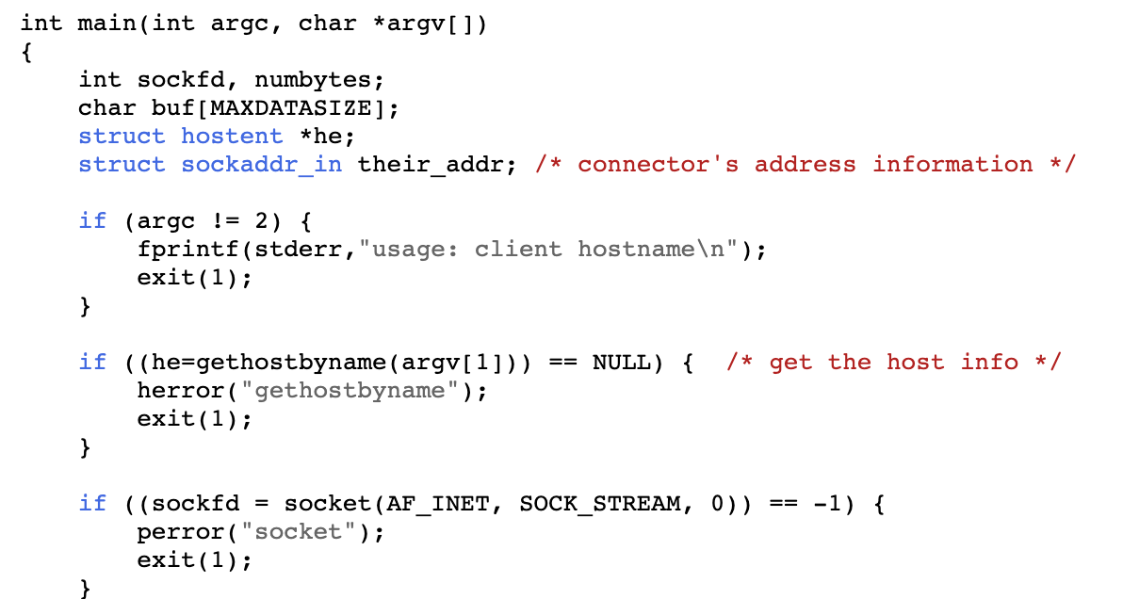
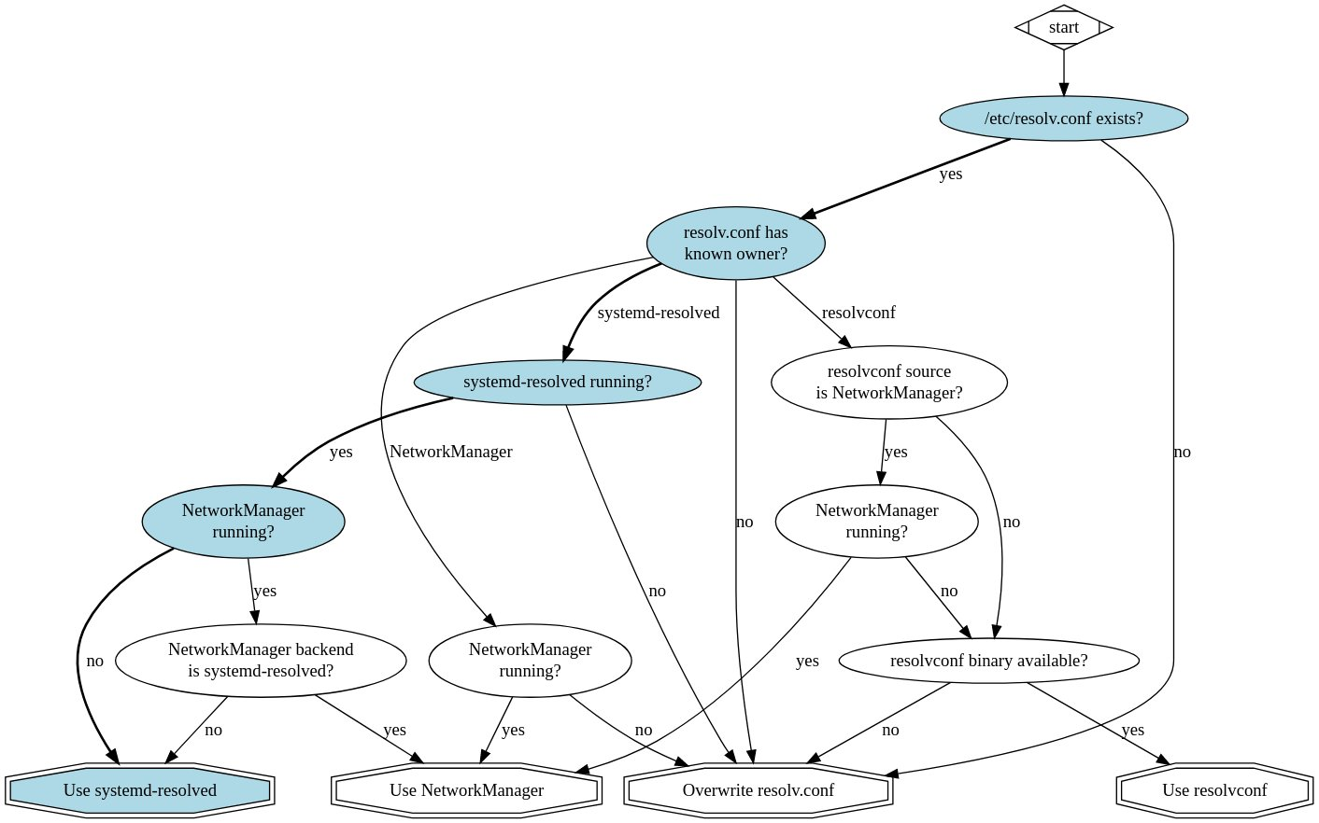


Apps – Socket/Bind/Send/Connect? What is the dst IP for x.y.z?
gethostbyname(3) is not a syscall. Though it eventually uses syscalls to perform the DNS over UDP dance (or DNS/https over TCP). The call is subject to configuration (mount namespaces, dhcp config, local cache such as dnsmasq and it is own cache implementation).
gethostbyname(3) is a library call (e.g., glibc or musl). And most probably your language does something funky on top of it.
Due to divergent implementations, Local/Remote DNS cache, DNS recursion you end up with a mess.
YMMV .. Solution: RTFM.. RTFC (C == code).
@dave_universetf/status/1382115734667489281

Slide 11
Ok sending.. How does it really look like? (UDP)
One of write style sys calls such as send(2), write(2), writev(2) or connect(2)*
sock_sendmsg
inet_sendmsg
udp_sendmsg
udp_push_pending_frames (SKB created!)
udp_send_skb
ip_send_skb
ip_local_out
__ip_local_out
nf_hook (NF_INET_LOCAL_OUT)
nf_hook_slow
nf_queue
__nf_queue
Note: use https://elixir.bootlin.com/ to lookup symbols above. The difference between __ prefixed funcs and their counter parts is usually error handling. Some ___ prefixed funcs have been omitted.
Note: skb links to socket that created it. Other state data are linked to sock (as part of creating the sock) such as device, buffers, settings, connection state etc. some available helper functions such as inet_sk(sk), sock_net(sk)

Slide 12
sk_buff created by protocol layer *must* be ready to transmit
What does ready mean?
Has a route, but not necessarily MAC addresses
Has MTU (which may lead to defrag, if offload is not employed) => local MTU and path mtu discovered.
Racy (TCP/IP): Imagine connect(2) followed by send(2) => handled by TCP protocol.
TCP/IP specific: nagle algrothim*
Who Carries the burden of getting and setting these things?
The application (userspace thread running in kernel mode). Protocol implementation covers its own details, asking lower layers to own their own.
IOW sk_buff is made complete by the application running in kernel mode.

Slide 13
On Routing
For TCP (Server): Destination is set on the socket itself upon creating the connection socket itself. Sending packets to connected client is a function of copying (and verifying the dst).
For TCP (Client): Destination is set on connect(2) call.
For UDP: destination is checked on every datagram.
For All: In all cases the src mac address is the from the device attached to the socket, device gets attached to socket upon creation specifically bind(2) call.
For new destination mac a combination of route tables and and arp protocol is used to resolve the mac address of the destination.
For gory details: offered /net/ipv{4,6}/route.c is used to load up dst as (struct dst_entry).

Slide 14
Getting dst mac
First: we need to route. IOW find who should receive this destination which can be:
A terminal endpoint: Same LAN, same subnet, same net. IOW ARPed network (sometimes referred as connected-to-same-router).
A router: If the receiving endpoint MAC addr is not something we can learn then we use router (e.g., gateway) own mac.
In both cases routing tables are consulted. Remember: Routes are longest prefix match.
If we don’t know the destination mac then we need to get it, enter ARP protocol implemented and cached in kernel by /net/core/neighbour.c
Notes on ARP
Generally there are two types of arp:
Request/response style: usually originating from “I need to send to this IP what is its ARP?”
Gratuitous: When an endpoint announce itself to everyone in the network.
Note: source mac is written at the lowest part of the layer because

Slide 15
On Checksums
Each header carries a checksum (cue the opening of Hitchhiker Guide to the Galaxy Opening Line). IOW it was such a bad idea that QUIC does not have checksum and relays on UDP’s.
For eth header depending on the carrier the csum calculation will change, but most of what you will see is CRC32.
For IP always 1’s complement of sum of header components.
For higher level protocols (UDP/TCP) it is done as 1’s completement sum of protocol header + IP pseudo header (srcIP, dstIP, and protocl). Note: udp inverts all bits to 1s if the sum == 0.
For IP/UDP/TCP the verification is done by 1’s completement of sum of header components (including checksum component) if != 0 then error is detected, and packet discarded.
Checksum is not _exactly_ a compute intensive operation, but for millions of packet per second it is. Most nic h/w can compute outer checks (and some do it for inner YMMV). More details here https://www.kernel.org/doc/html/latest/networking/checksum-offloads.html
Similarly, checksum verification can be done on nic ethtool is used to change configuration (for more details: https://docs.gz.ro/tuning-network-cards-on-linux.html)
YMMV specially in virtualized environments.

Slide 16
On MTU
There are two relevant MTUs.
The sending device: The fragmentation happens at the IP layer.
The path mtu: multi hop networking means that there might be a router on the path. For that PMTUd is used
Set on sock by IP_MTU_DISCOVER via setsockopt(2)
Inherited from /proc/sys/net/ipv4/ip_no_pmtu_disc
For both cases PMTUd is done by sending a packet with do-not-frag on and waiting for ICMP type3/code4 responses. The process usually runs multiple times usually at 10m intervals.
PMTUd RFC-1163 is a technique and a non-binding standards widely used practice, and has its own drawbacks.
You always work with the smaller MTU.
RFC 1981 for IPv6 similarly proposes a similar approach. The only difference is the assumption that path.mtu == first-hope.mtu. Note IPv6 does not support packet fragmentation.
What Now?
Best is to use a known mtu, if your box always talk with known destination then set them on the nic itself. There are common rules such as 1500 for internet destinated packet.
For IPv6 use min MTU if you don’t know if the path supports larger.
Packet fragmentation is bad but not that bad specially for non perf sensitive workloads.
The path between point A and point B on the internet is ever changing. Accordingly, MTU as well. (them the rules!).
Why should I prefer larger MTU?
Routing, sending, receiving, processing (that is everything we talked about so far) is done on-per-frame-bases. Larger mtu means less frames for the same sized data == less cpu cycles == less cost per packet/faster transmit even on the same bandwidth.

Slide 17
Kernel + TCP/IP

Slide 18
TCP/IP Keep alive and retransmission
Keep a live:
When sockets (in TCP/IP case the connection, not the listener) are constructed. The protocol specific settings (such as keep alive) are inherited from system /proc/sys/net/ipvX/tcp_keepalive_{time, intvl, probes} and then modified by setsockopt(2).
kernel TCP implementation /net/ipv{4,6}/inet{4,6}_connection_sock.c wires up calls back to kernel timer according to settings. Kernel timer is exactly as it sounds, a facility provided by kernel /kernel/time where various pieces of kernel can add “future call backs”.
Incoming keep-alive packets updates connection state (attached to socket as struct inet_connection_sock). An interval runs to
Send keep a lives (by checking time-of-past-send > interval).
Terminate dead connections (following connection tear down state machine).
re-xmit:
TCPIP works on ack based. Where the sender expects the receiver to send back an ACK message with sequence # for each packet recieved. IRL:
Sender does not send per packet ACK e.g. /proc/sys/net/ipv{4,6}/tcp_ato_min controls initial ack interval per ms.
/proc/sys/net/ipv{4,6}/tcp_delack_min is ms ack after connection has been established.
A timer is set for segments with no ack received, when expired the segment is resent.
/proc/sys/net/ipv{4,6}/tcp_retries2 controls the timeout after all keep alive, re-xmit (normal and fast) before signaling connection issues.
Fast re-xmit (RFC:5682):
On 3rd duplicated ack linux assumes that receiver have not received the last segments (dupAck.Seq++) And starts retransmitting the data without waiting for timer to expire.
The settings is controlled by (on/off flag) /proc/sys/net/ipv{4,6}/tcp_frto
netstat -S reports segment retransmission.
Note: TCP has many more knops check for doc (also read the RFCs) https://www.kernel.org/doc/Documentation/networking/ip-sysctl.txt

Slide 19
TCP/IP Congestion Control (RFC:5681)
This is Transmission Control Protocol specific algorithm and does not kick in if you are dropping packets due to memory pressure but may kick-in after.
101 CC
Receiver uses TCP segment's window size field to state how much data it is willing to receive when sending ack message back.
Initially window size == MSS || MTU – (headers).
Two logical variables are maintained:
CWND: Congestion Window – active send rate.
RWND: MAX send rate.
Linux employs algorithms (VEGAS, CUBIC, VENO, H-TCP, WESTWOOD, TAHO, RENO, and most recently kernel v4.9 google’s BBR – v2 is still preview as of writing) they work on trying to find the maximum CWND for each socket. Note two sockets to same destination may have two different CWNDs. Good context is here: https://arxiv.org/pdf/1605.01987.pdf
Algo is set using /proc/sys/net/ipv{4,6}/tcp_congestion_control
Note: plenty of other settings exist for congestion control check: https://www.kernel.org/doc/Documentation/networking/ip-sysctl.txt
Note*: This is implemented by the protocol not by TC. Hence this is all happens before TC takes over with qdisc.
Nagle Algorithms
The basic idea is small packets are bad. So sending larger packets (by stalling send a little bit) is generally better for slower networks and/or non latency sensitive applications (and obviously where applications tend to trickle-down-sends remember write(2) v writev(2)?).
Similarly sending more data while a lot of sent data has not been acked yet might overwhelming the receiver.
TCP_NODELAY is a socket option disable nagle algorithm on socket (on per connected socket bases).

Slide 20
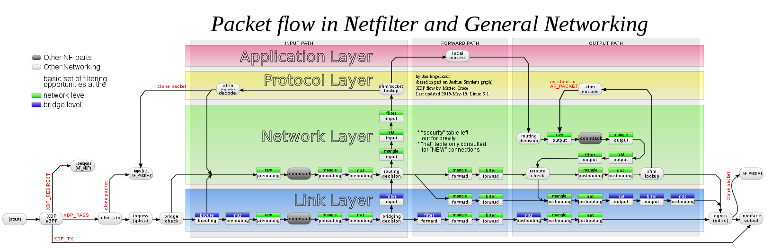
By now this – hopefully – makes a lot more sense..
Source: commons.wikimedia.org/wiki/File:Netfilter-packet-flow.svg

Slide 21
Ok, what did we not cover? .. A lot
Sk_buff linearization
Offloading (RSO, GSO, USO, TSO,…)
TC=>Device Queue Relationship
Stacked net devs
The entire NF_QUEUE(..) dance.
And a lot more, Where can I discover them
Favorite: Reading struct sk_buff then interrogate the kernel on who is using that field?
Tip: Understand the protocol before attempting to understand the code
Old (2005): Understanding Linux Networking Internals.
Reading docs, lkml, lore and most importantly the code*.
Reading aux code such as DPDK.

